Slide 1


Slide 2
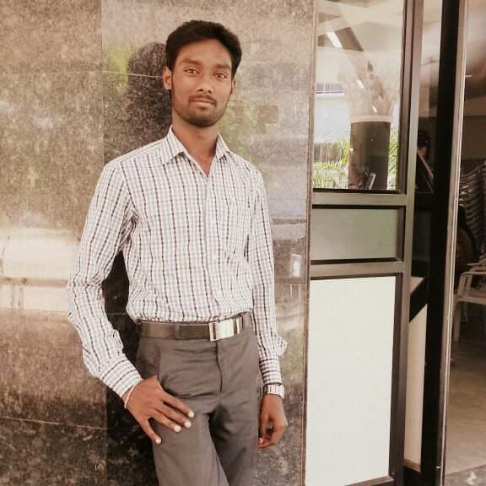
Effective Communication Skills
k.Syed abthaheer,
m.a.,m.phil.,b.ed.,pgdca
Assistant professor,
Dept.of English,
Jamal mohamed college
(autonomous)
Trichy-20.
syedabutrichy@gmail.com
90426 80796

Slide 3
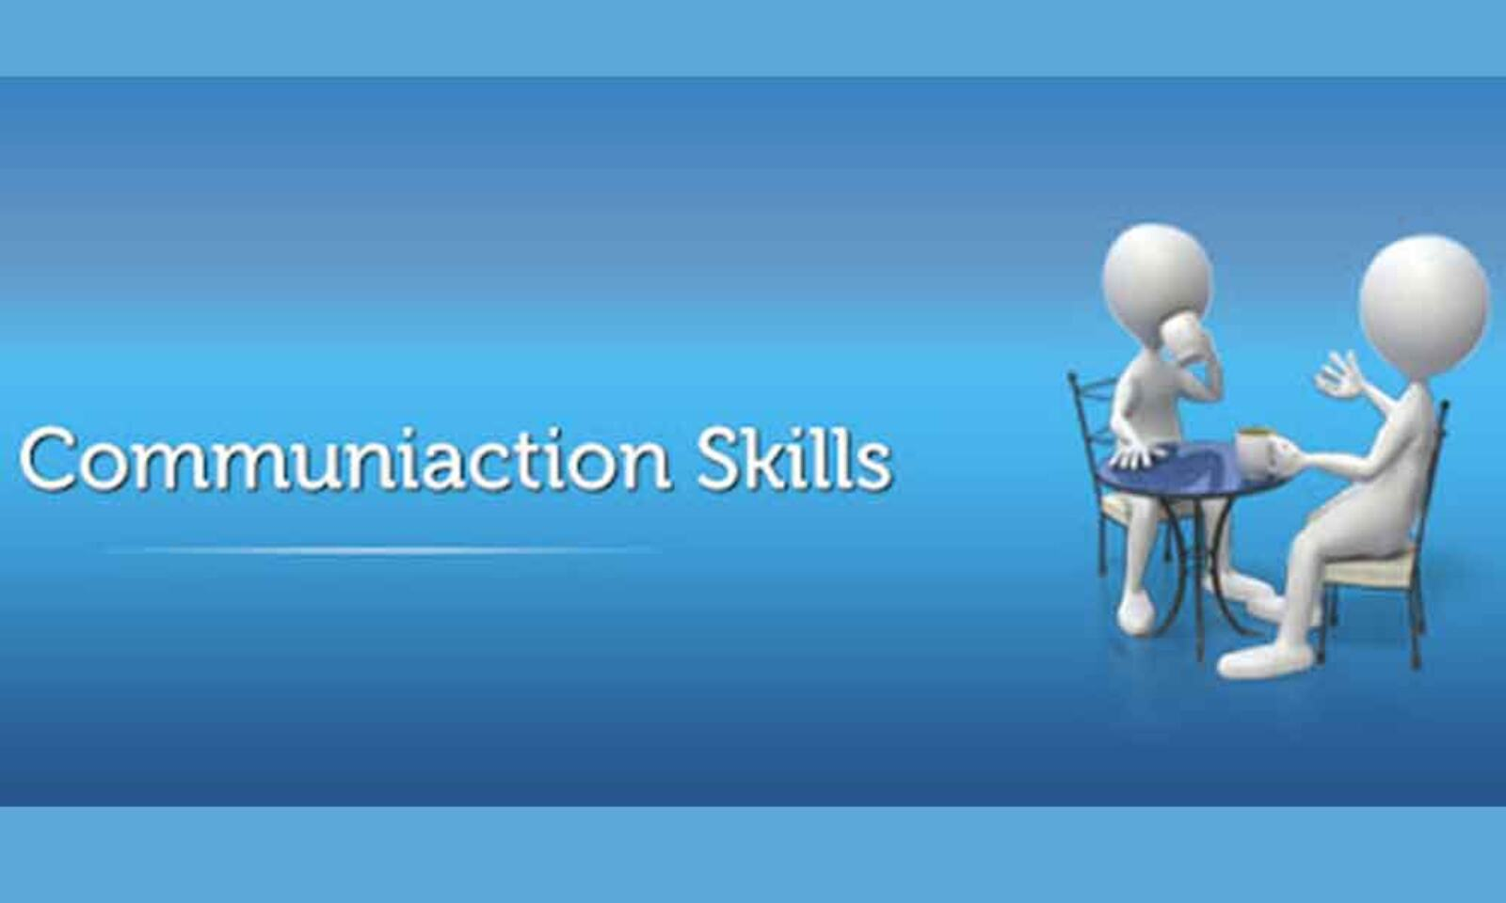

Slide 4

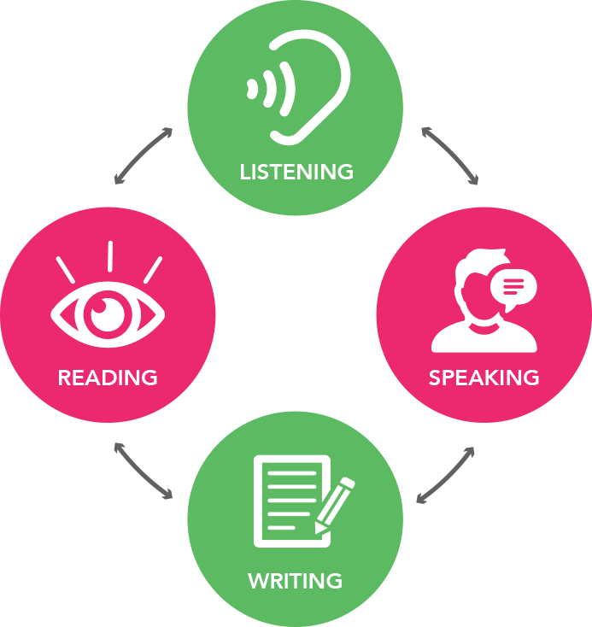
  L S R W
1.Listening
2.Speaking
3.Reading
4.Writing

Slide 5
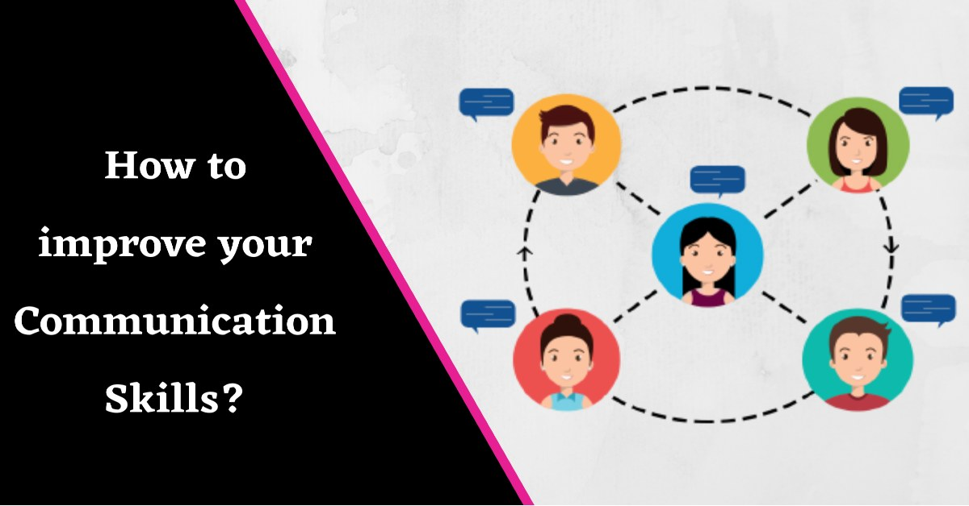
communication

Slide 6
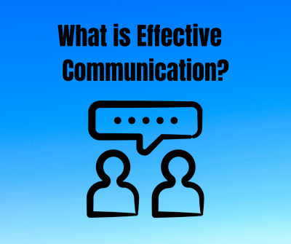
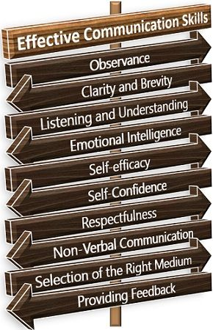

Slide 7
Effective Communication skills
*Be an attentive listener.
*Be concrete and clear.
*Non-verbal communication is the key.
*Be relaxed.
*Inform.
*Be visual.
*Show empathy.
*Completeness.

Slide 8
Conclusion
*Giving and receiving feedback is essential and one of the core skills for effective communication.
*The better the understanding you would have about your team members, the better you would be able to communicate with them.
*Stress and anxiety can ruin your communication and discourage you. Both these things can cause you to be an ineffective communicator.
* Developing these skills can help you to communicate effectively with others.

Slide 9


Slide 10

Created by
K.SYED ABTHAHEER
M.A.,M.Phil.,B.Ed.,PGDCA
Assistant Professor of English,
Jamal Mohamed College
(Autonomous)
Trichy-20.
syedabutrichy@gmail.com
90426 80796

